Slide 1

Using R as a Research Tool.
NERC E3 DTP Training – 28th November
Dr Susan Johnston, Institute of Evolutionary Biology
Demonstrators: Gergana Daskalova, John Godlee

Slide 2
Today’s session:
Write, embed and render code and results into an HTML document.
Carry out basic statistics and visualisations, including:
Chi-squared test with chisq.test()
2-sample t-test with t.test()
Linear regression with lm()

Slide 3
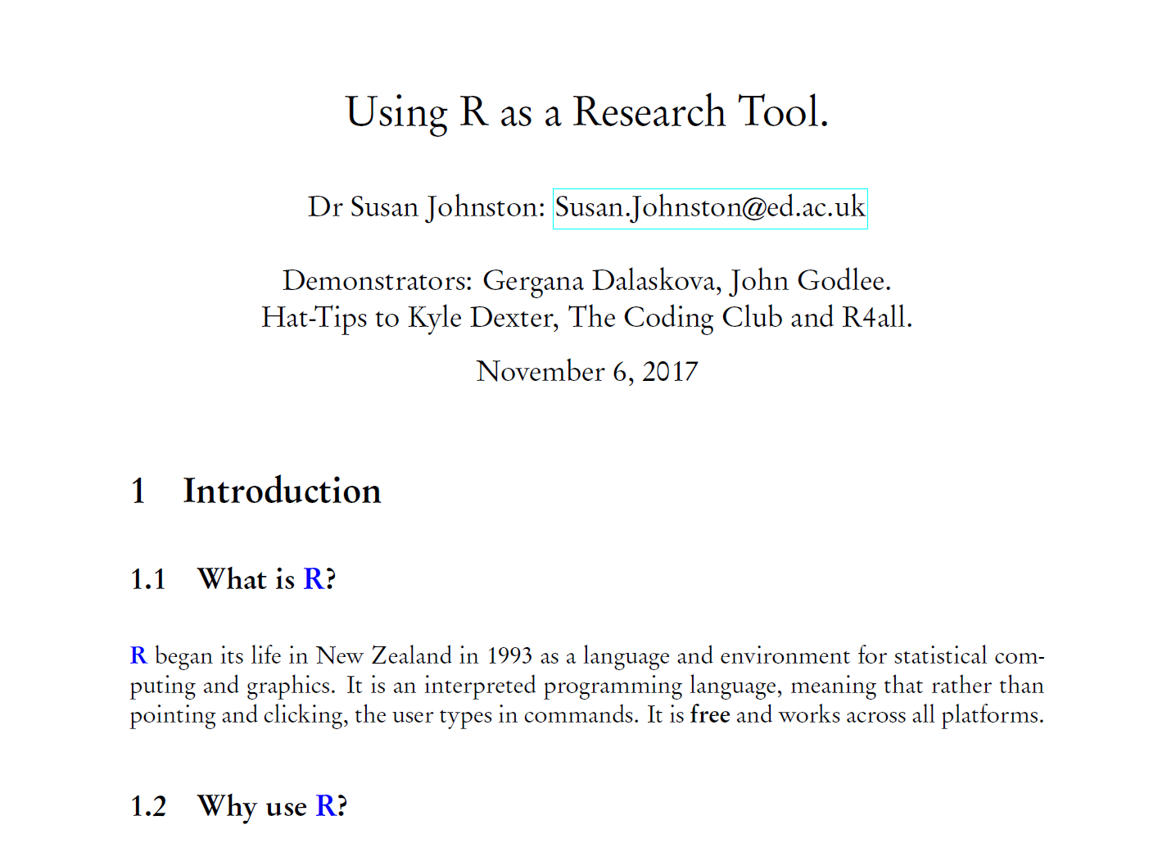
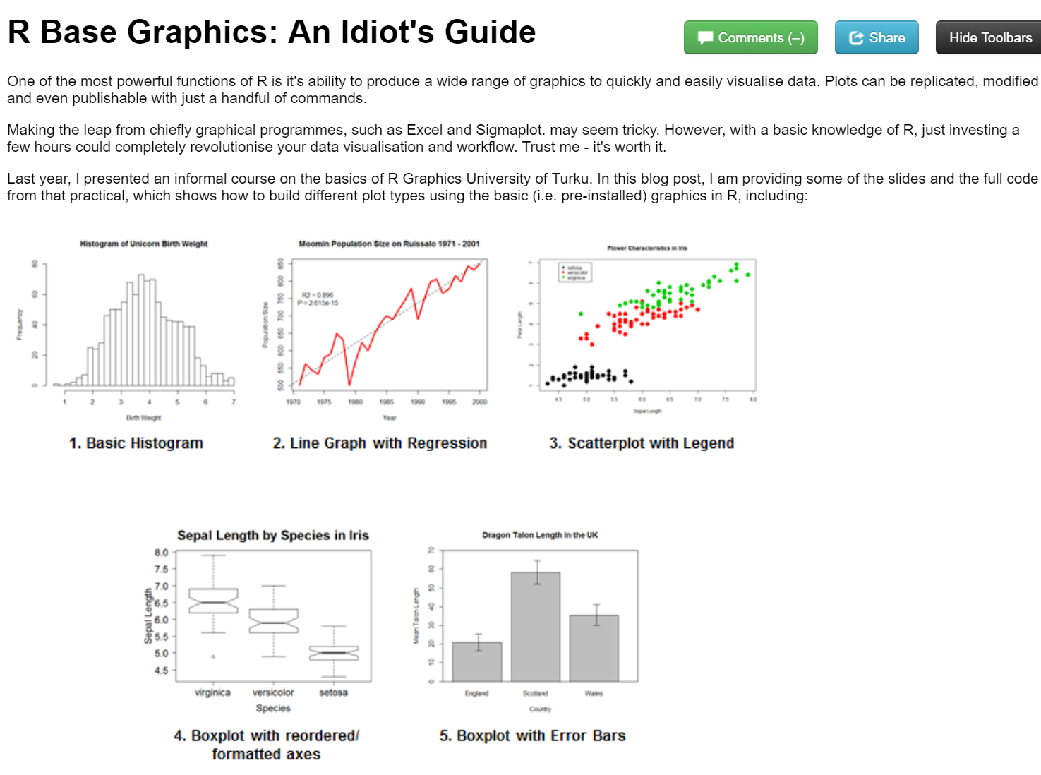
Report writing
LaTeX and R Sweave
knitr to HTML

Slide 4
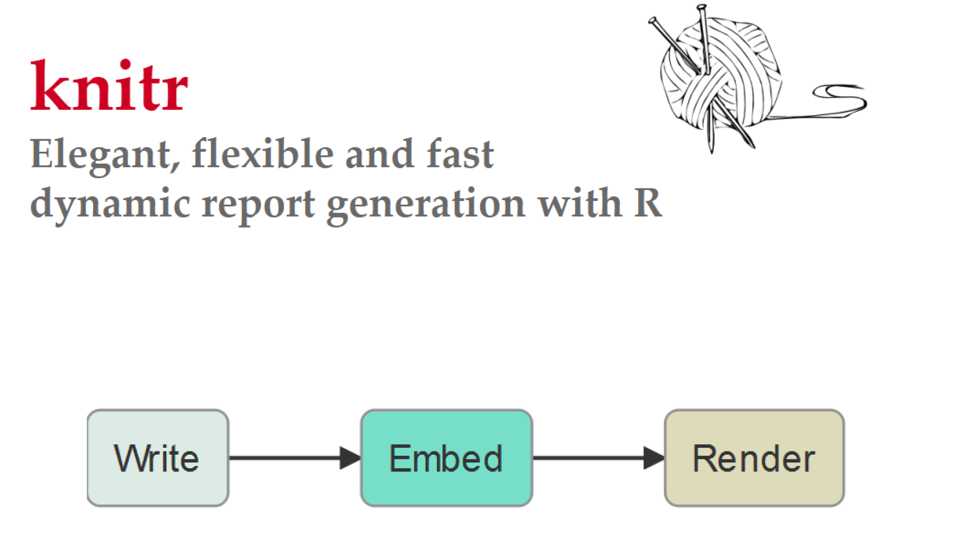
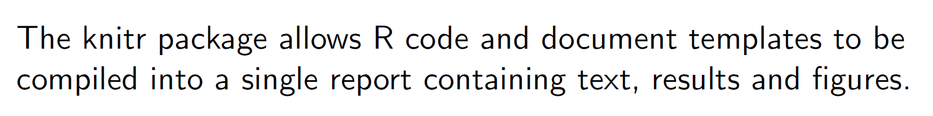

Slide 5
Worked example…

Slide 6
Today’s session:
Write, embed and render code and results into an HTML document.
Carry out basic statistics and visualisations, including:
Chi-squared test with chisq.test()
2-sample t-test with t.test()
Linear regression with lm()

Slide 7
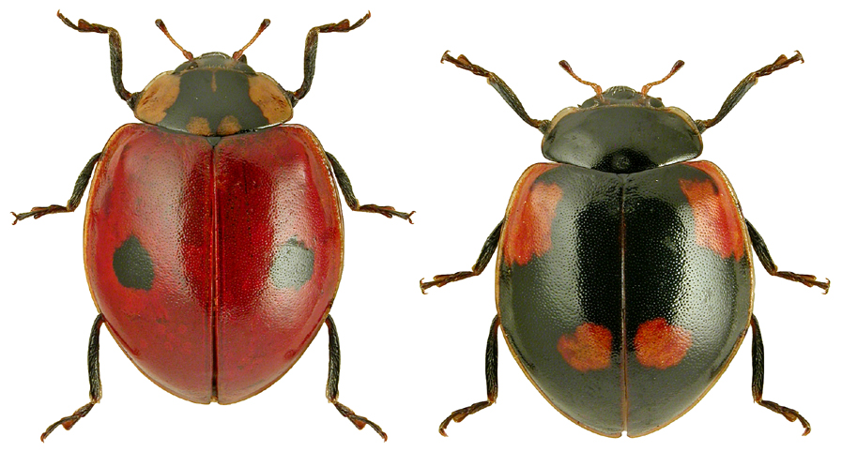
Chi-squared (χ²) contingency table
Analysis of count data
Are lark ladybirds more likely to live in industrial (dark) backgrounds?
Adalia bipunctata

Slide 8
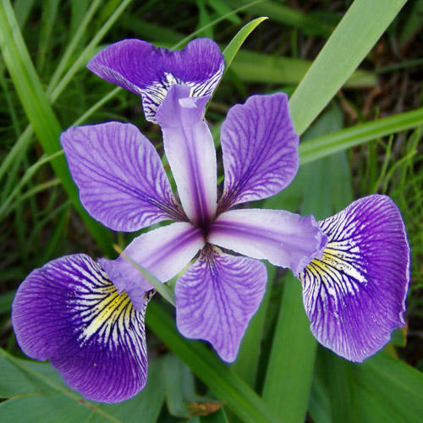
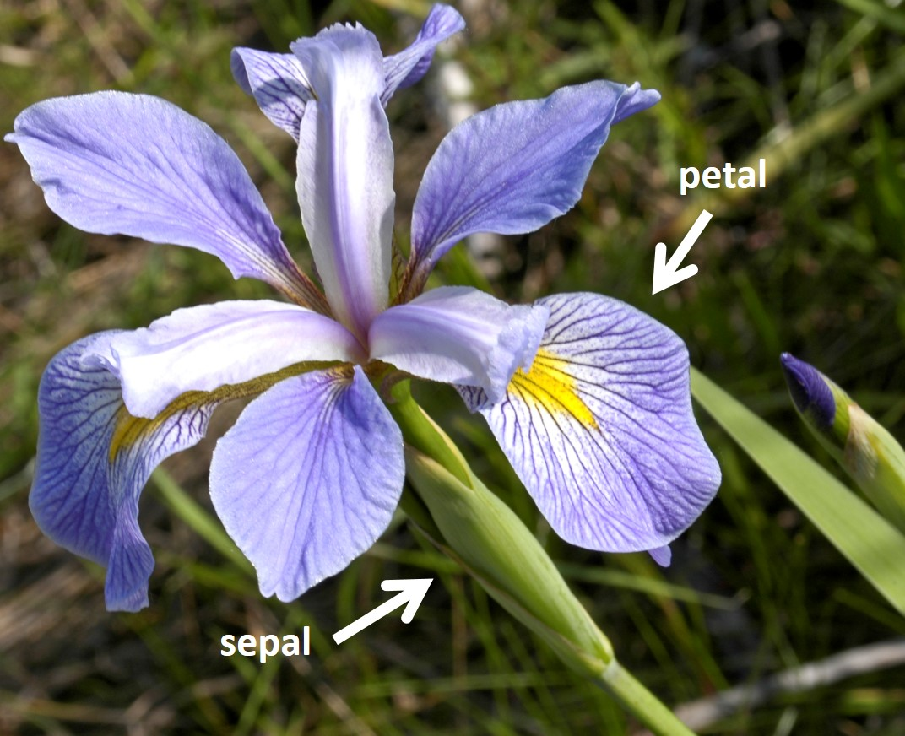
Two sample t-test
Compares the mean of two groups.
Are sepal lengths significantly different between these two species of Iris?
Iris versicolor Iris virginica

Slide 9
Simple linear regression

Slide 10
Need help?
ASK US!
Use ?, str(), glimpse() to explore functions and objects.
Coding Club tutorials: https://ourcodingclub.github.io/tutorials/
Google & StackOverflow

